Slide 1
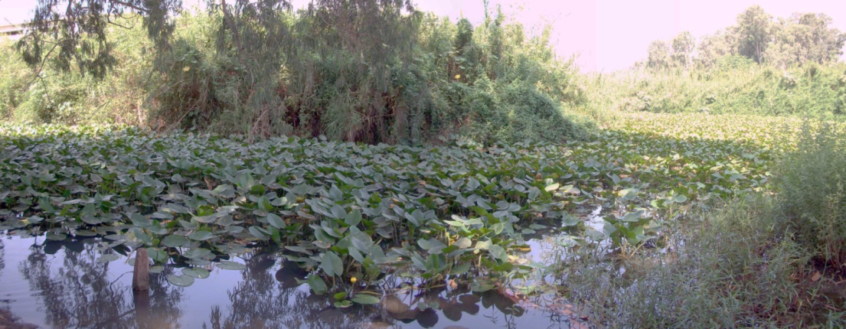
Anti-Inflammatory and Anti-Cancer effects of thioalkaloids from Nuphar lutea (yellow Water Lilly).

Slide 2
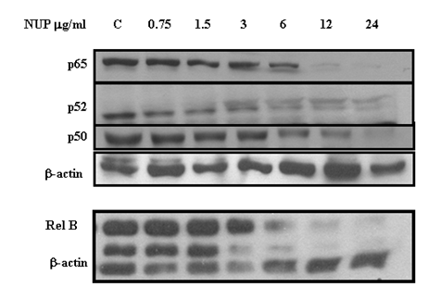
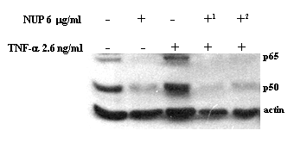
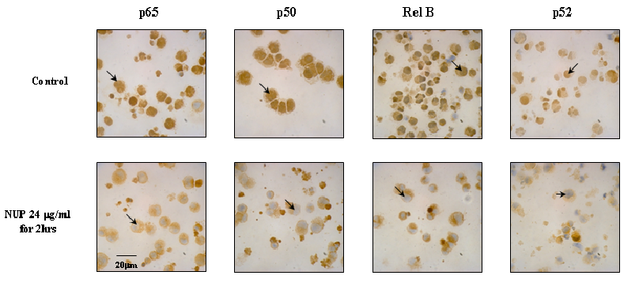
MCF-7 Breast cancer cell line
Ozer J et al.Cancer Biol Ther. 2009 Oct;8(19):1860-8

Slide 3
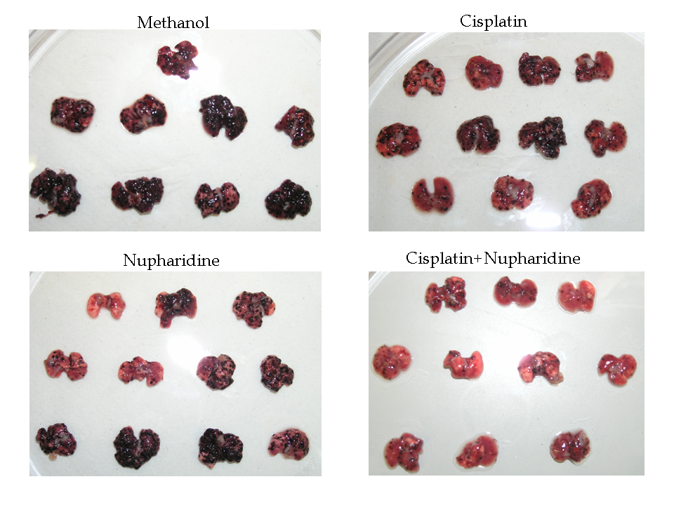
Vehicle
NUP
Cisplatin
NUP+Cisplatin

Slide 4
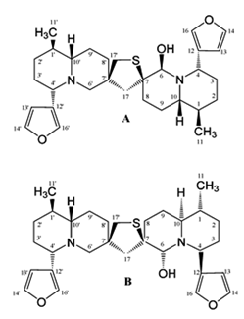
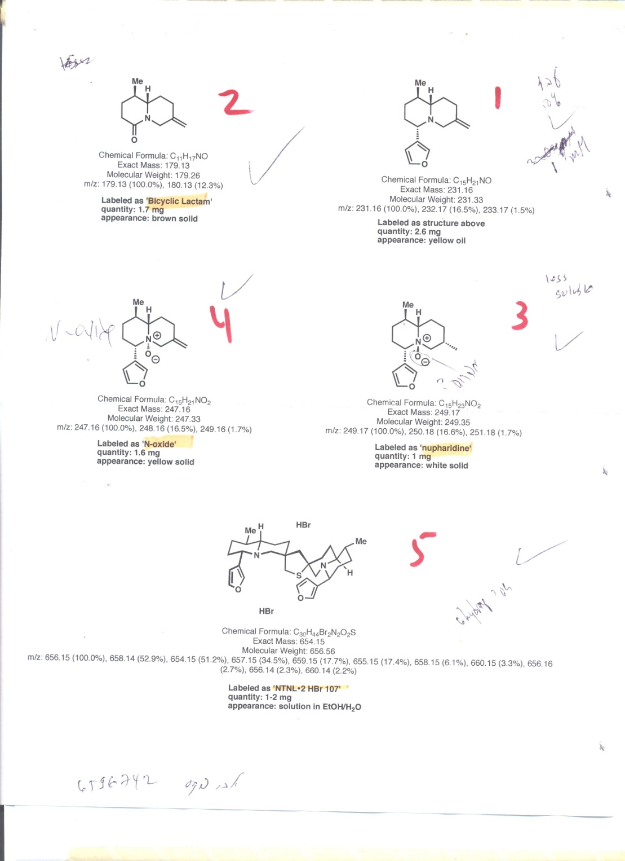
6-hydroxythiobinupharidine
6-hydroxythionuphlutine B

Slide 5
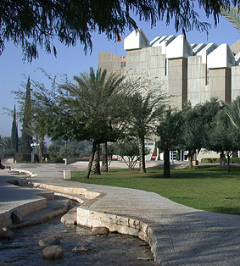
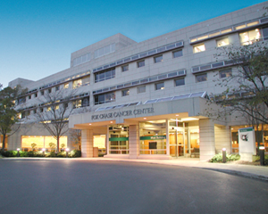
The role of host-encoded microRNAs in maintaining measles virus persistence
Glenn Rall Ph.D.
Program in Immune Cell Development and Host Defense, Fox Chase Cancer Center, Philadelphia, USA.
Jacob Gopas Ph.D.
Department of Microbiology and Immunology, Faculty of Health Sciences.
Ben Gurion University and
Laboratory of Oncology
Soroka Medical Center
Beer Sheva, Israel

Slide 6
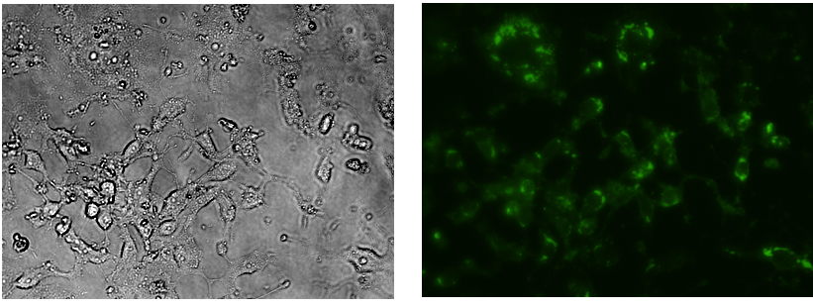
Expression of Measles Virus P-protein
Vero-SLAM- GFP-P protein
Western blot
L428MV
L428
KMH2MV
KMH2
UKFMV
VEROMV
VERO
2716MV
UKF
NS20
Measles P-protein

Slide 10
Alterations in miRNA levels in cells infected with measles . The results demonstrate the difference between uninfected cells to infected cells. Each cell line was tested at least by triplicate. Each miRNA was examined in three different libraries of each cell line.
Has-222-3p is down-regulated in infected KMH-2 and UKF cells. Has-124-3p is up-regulated in infected UKF cells.

