Slide 1

David Stepensky
Department of Clinical Biochemistry and Pharmacology
and School of Pharmacy
Faculty of Health Sciences
http://fohs.bgu.ac.il/homes/stepensky
M6 bldg., room 529
08-6477381
Research topics:
Drug delivery and targeting, controlled release dosage forms (nanoparticles, liposomes)
Targeting of biopharmaceuticals using on the organ/tissue and intracellular levels
Preclinical and clinical pharmacokinetics and pharmacodynamics, PK/PD modeling
Seeks cooperation in the following areas: development of new drugs, more efficient use of the existing drugs, investigating the mechanisms of action of drug leads
Selected recent publications:
Sneh-Edri H, Likhtenshtein D, Stepensky D. Intracellular targeting of PLGA nanoparticles encapsulating antigenic peptide to the endoplasmic reticulum of dendritic cells and its effect on antigen cross-presentation in vitro. Mol Pharmaceutics 2011; 8(4):1266-75.
Dakwar G, Hammad IA, Popov M, Linder C, Grinberg S, Heldman E, Stepensky D. Delivery of proteins to the brain by bolaamphiphilic nano-sized vesicles. J Control Release 2012; 160(2):315-21.
Stepensky D. Local vs. systemic anti-TNF-alpha effects of adalimumab in rheumatoid arthritis: pharmacokinetic modeling analysis of interaction between a soluble target and a drug. Clin Pharmacokinet 2012; 51(7):443-55.

Slide 2
drug targeting
intracellular targeting of nanoparticles

Slide 3
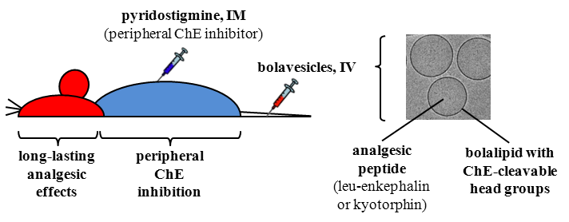
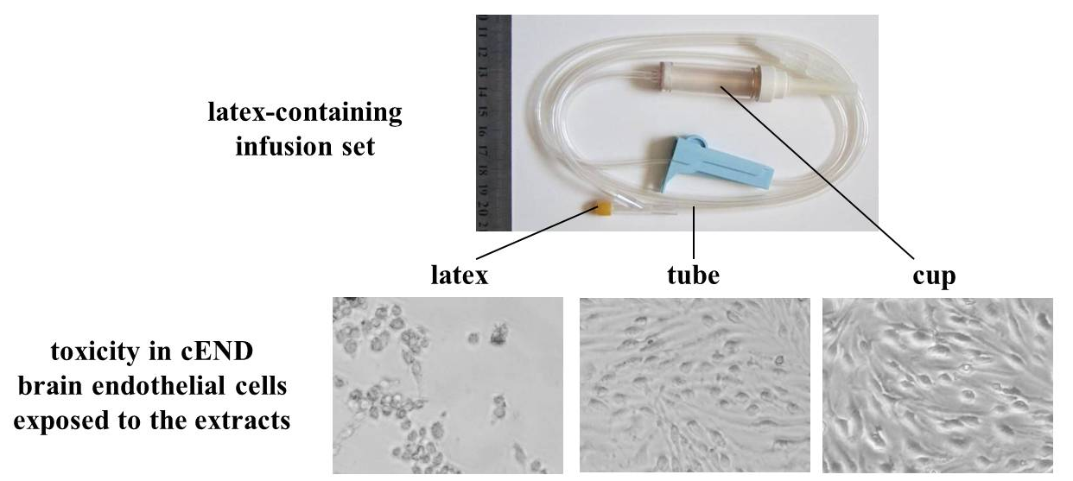
Brain-targeted drug delivery using nanovesicles
Toxicity assessment of drugs and disposable devices

