Slide 1
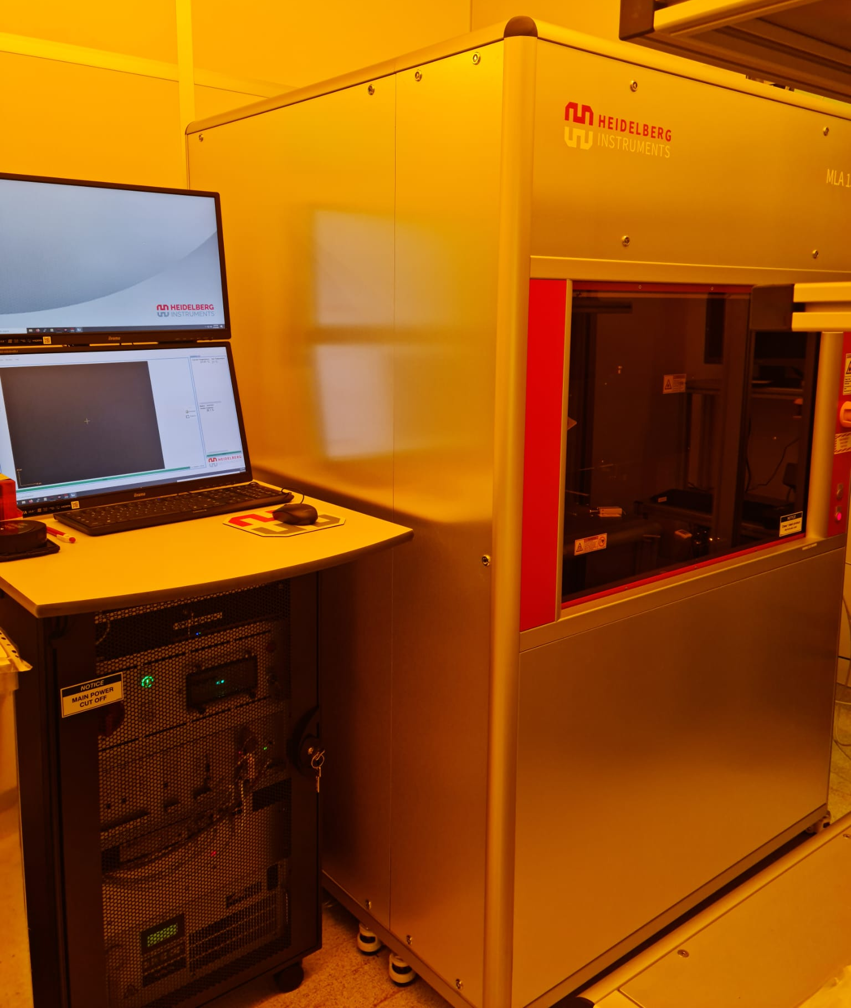
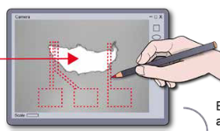
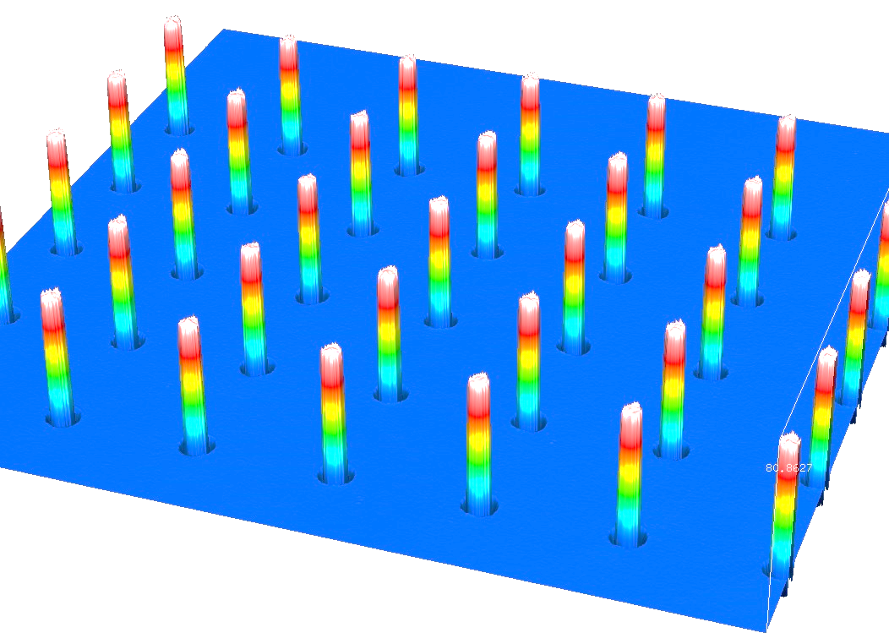
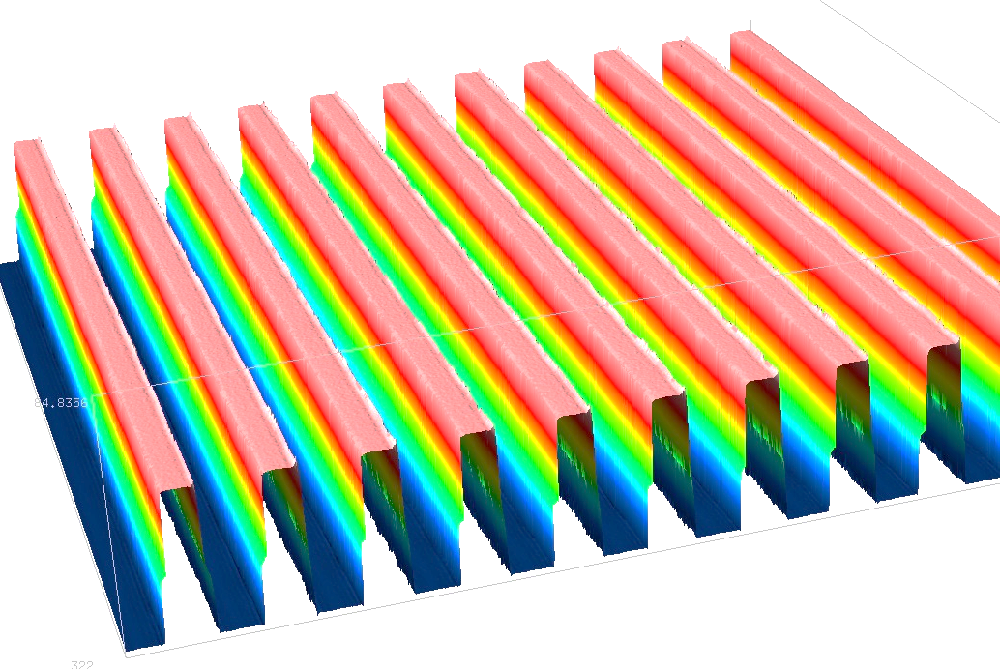
Heidelberg Instruments MLA 150
Maskless Aligner
Description
The MLA 150 is a cutting-edge Maskless Aligner system designed for high-precision photolithography. The operation principle of the MLA 150 eliminates the need for traditional photomasks by projecting the desired pattern directly onto the photoresist-coated substrate. This method enables on-the-fly adjustments and modifications to the pattern, significantly reducing the time and cost associated with mask production. In addition, the system includes Draw Exposure Mode, facilitating the ability to make small changes or repairs to existing structures or to create electrical contacts to nanowires or graphene flakes.
Specifications/Capabilities
Minimum feature size: 1 [μm]. Global 2nd layer alignment: 500[nm]. Global backside alignment: 1 [μm]. Light source: UV Diode Laser 375 [nm], 7.2[W]. High aspect ratio mode for thick photoresists. Maximum exposure area: 200 x 200 mm² . Draw Exposure Mode.
Draw Exposure Mode
SU-8 photoresist ~50 [μm].
Link
https://heidelberg-instruments.com/product/mla150/

