Slide 1
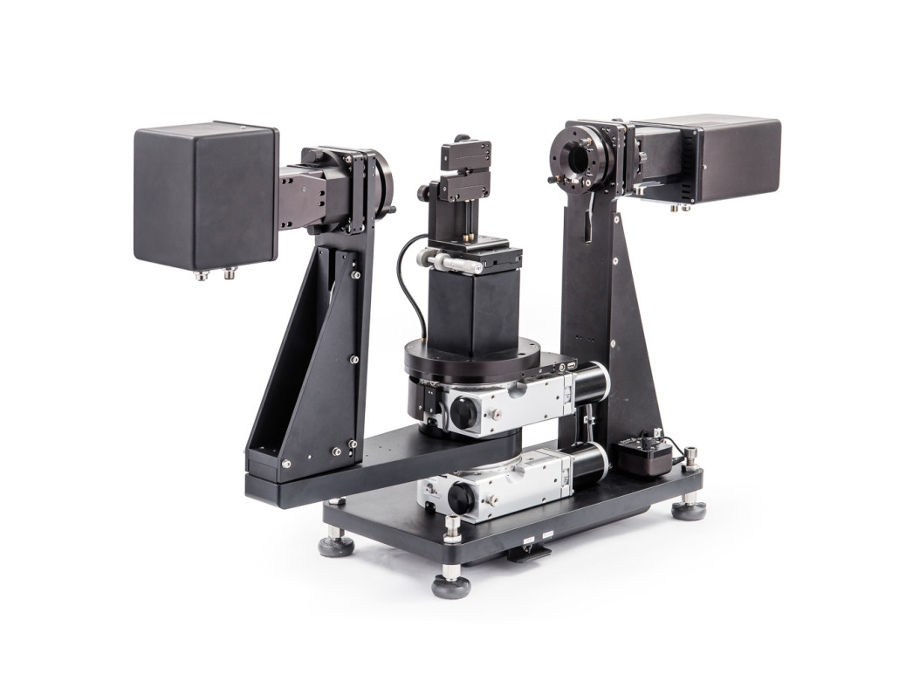
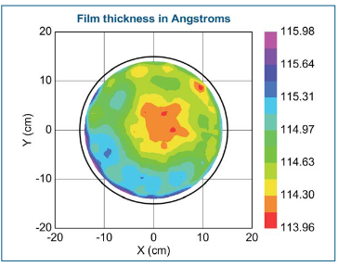
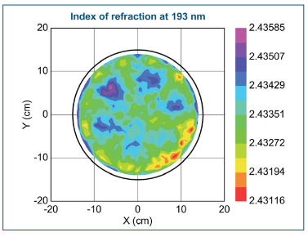
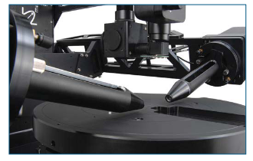
J.A Woollam RC2 Spectroscopic Ellipsometer
Description
The J.A Woollam RC2 spectroscopic ellipsometer is a cutting-edge instrument designed for advanced thin film characterization, spanning the ultraviolet (UV) to near-infrared (NIR) spectral range (210 - 1700 nm). It enables detailed analysis of material properties through automated measurements across various incidence angles. The system includes an automated mapping stage for uniformity analysis, characterization of complex anisotropic samples, a temperature-dependent stage, a camera for viewing the beam location on the sample, and focusing optics for precise feature size measurements.
Specifications/Capabilities
Spectral range: 210 - 1700 nm. Automated measurements with an auto angle range of 45° to 90°. 100 x 100 mm XY Mapping . Focused beam diameter (~300 μm ). Sample beam location viewed via camera. Full Mueller matrix characterization (16 elements).
Focusing probes
Link
https://www.jawoollam.com/products/rc2-ellipsometer

