Slide 1
Raz Jelinek
Ben-Gurion University of the Negev
Beersheva 84105, Israel
Chromatic Lipid/Polymer Vesicles for Membrane Studies and Diagnostic Applications

Slide 2
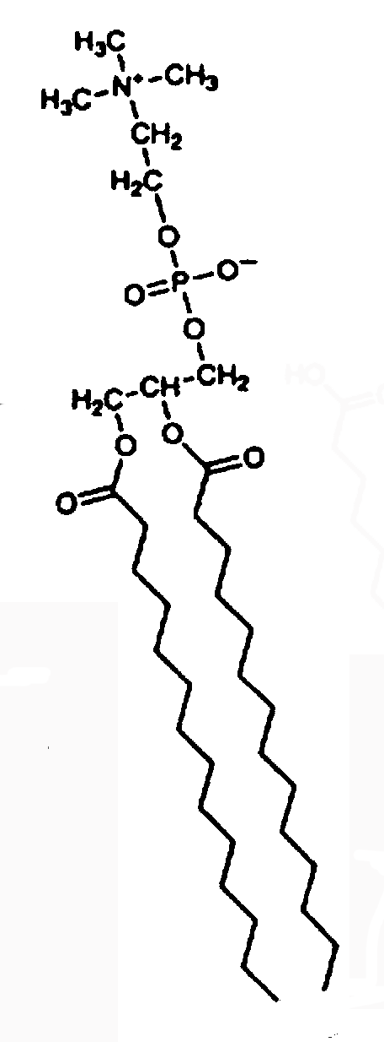
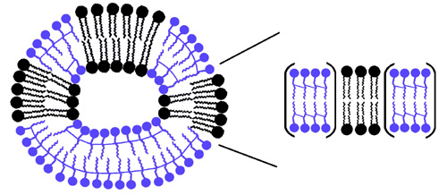
Lipid / polydiacetylene (PDA) vesicles
Natural or
synthetic lipids
Diacetylene
- Sonication
- UV 254 nm
PDA
PDA
Lipids

Slide 3
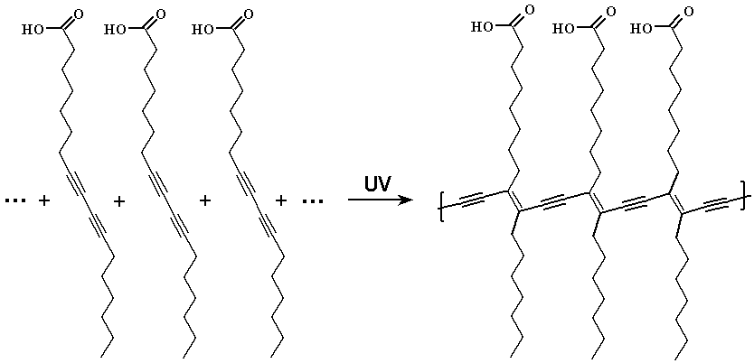
Polydiacetylene (PDA) – a conjugated polymer
254 nm
Blue Phase
Red Phase

Slide 4
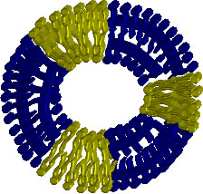
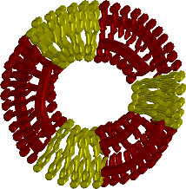
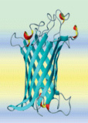
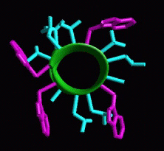
Color detection of membrane-active compounds
Polymer
Lipids
+

Slide 5
Vesicles with different lipid compositions
Sphingomyelinase
galactosidase
PLA2
PC
sphingomyelin
cerebroside

Slide 6
Chromatic response depends upon lipid composition
PLA2
CERase
- PDA/Sph,
- PDA/CB,
- PDA/PC,
SMase
Lipids
Enzymes

Slide 7
sol-gel containing lipid/PDA vesicles

Slide 8
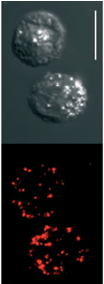
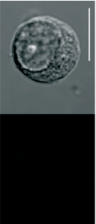
Polymer-labeled live cell biosensors
Membrane-active compounds
Orynbayeva et al., Angew. Chem. Intl. Ed. (2005) 44 1092-1096

Slide 9
Possible collaboratios:
Membrane processes
Diagnostics schemes

