Slide 1
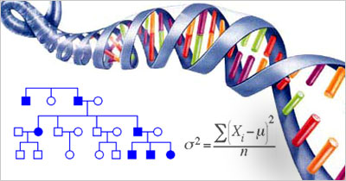
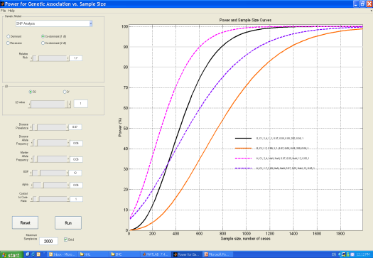
Genetic Epidemiology of complex diseases
Idan Menashe, PhD Department of Public Health
Faculty of Health Sciences Phone: 972-8-6477456 Fax: 972-8-6477638
Email: idanmen@bgu.ac.il

Slide 2
Genetic Epidemiology - a hybrid of two scientific disciplines
Genetics
Epidemiology
Genes and inheritance
Risk factors and public health
Focus on genetic factors that contribute to the etiology of human multifactorial diseases
(e.g. cancer, diabetes, autism)

Slide 3
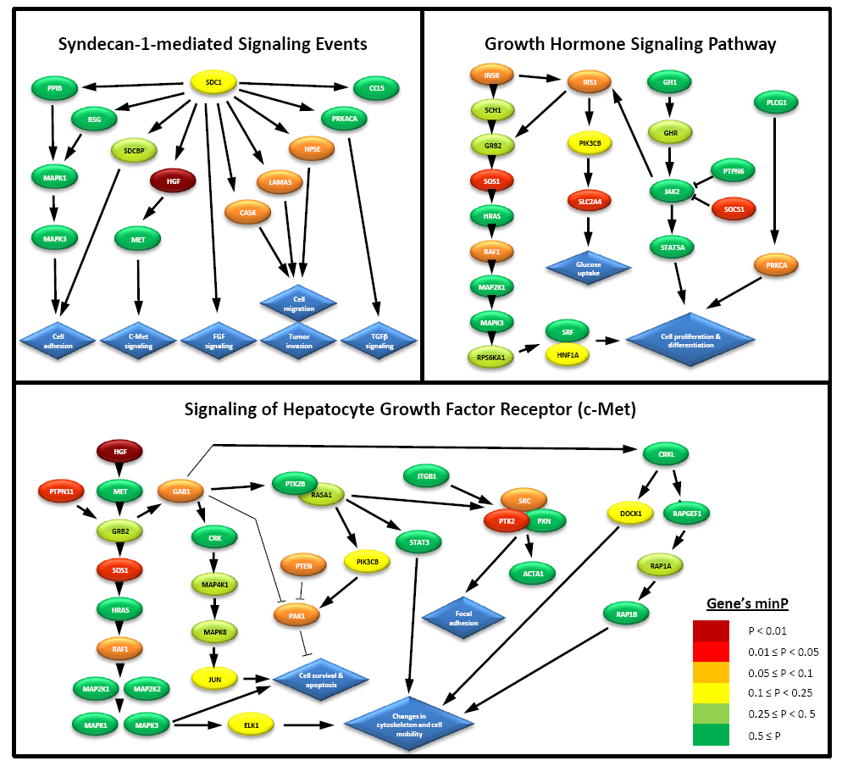
Examples of studies
Pathway analysis of genome-wide association studies
Meta-analysis of CNVs associated with autism
Cases
Controls (from DGV)

Slide 4
Research interests
Genetic epidemiology of autism spectrum disorder
Molecular classification of complex diseases
Gene-environment interactions in complex diseases
Population genetics (Evolutionary genetics)

Slide 5
Potential collaborators
My expertise
Genetic epidemiology (autism and cancer)
Biostatistics (statistical analysis of ‘omics’ data)
Computer and statistical software (Matlab, R, SPSS)
Groups with biological expertise than can investigate the functional link between specific genotypes and their associated phenotypes.
Groups who study multifactorial diseases.
Groups that produce large-scale ‘omics’ data.

