Slide 1
Lysine Methylation and Chromatin Biology Lab
Dan Levy
Faculty of Health sciences, Ben-Gurion University
Department of Microbiology, Immunology and Genetics
me

Slide 2
me
PTMs:
me
me
Methylation
me
Ph
Phosphorylation
TF
Ac
Acetylation
me
me
Ac
P
me
CLOSED
OPEN
Chromatin Dynamics
Inflammatory
disorders
How PTM’s influence
chromatin structural dynamics?
Cancer
Many others...
Gene expression programs in physiological and pathological processes
me
Methylation

Slide 3
Protein lysine methylation
protein lysine
methyltransferases
>50 PKMTs
>25 PKDMs
protein lysine
demethylases
Lysine
PKMT
Mono(me1)
PKMT
Di(me2)
PKMT
Tri(me3)
PKDM
PKDM
PKDM
me
H
me
H
me
me
me
H
H
H
H
me
me
+
N
+
+
N
N
+
N
K
K
K
K
Function A
Function B
Function C
Function D
Chromo
domains
PHD fingers
Ankyrin repeats
Tudor
domains
PWWP
domains
WD repeats
MBT domains
Methyl-lysine binding modules
“READERS”
Notes:
3

Slide 4
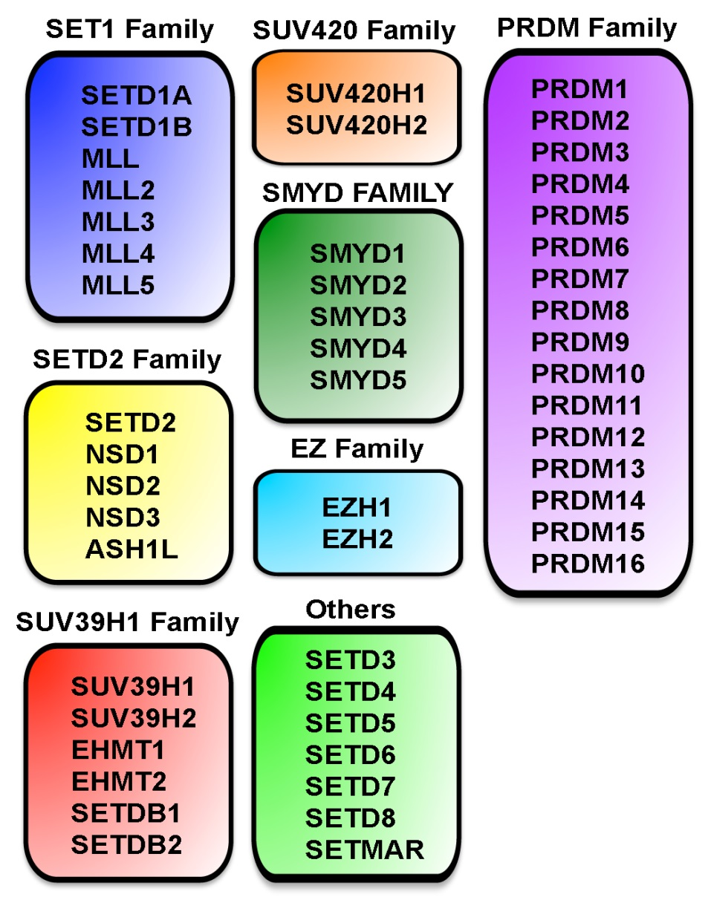
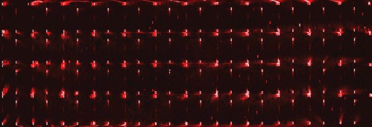
How to identify a new methylation event?
H3
H4
p53
Rb
H4
ERα
H2B
H2A
???
Histones
Non-histones
me
me
Candidate approach
me
?
Protein and peptide arrays
High throughput approach

Slide 5
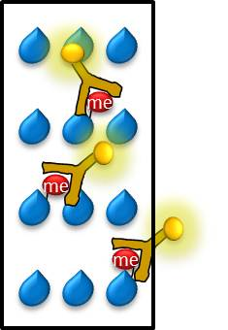
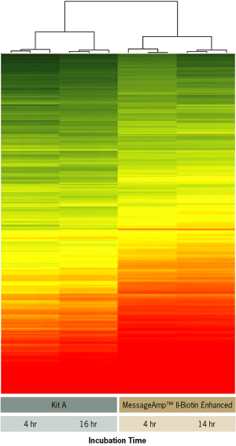
Biochemical
Proteomics
Cellular
Genomics
Methylation
event
Mechanisms
Function
Binders
Cancer
New Substrates
me
PKMT
K
A
B
C
D
Prot-Prot
Interaction
Cellular Methylation
pattern
Differentiation
me
me
Chromatin
structure
me
me
me
me
Ph
???
Ac
???

Slide 6
Thank you!

