Slide 1

Computer and Information
Science and Engineering (CISE)
Exploring the frontiers of computing
http://www.nsf.gov/dir/index.jsp?org=CISE
Jeremy Epstein
Program Director
May 2015

Slide 2

National Science Foundation’s Mission
“To promote the progress of science; to advance the national health, prosperity, and welfare; to secure the national defense...”
Notes:
NSF’s mission is to …
It is the ONLY agency that funds all fields of Science & Engineering
Half of NSF’s science staff are rotators or visiting scientists & engineers, providing subject matter expertise and leadership to the scientific community on a national-scale

Slide 3





Where Does NSF Fit?
Translation
Basic
Utility

Slide 4

Where do I find information about funding opportunities?
www.nsf.gov

Slide 5



NSF by the Numbers
$7.3
billion FY 2015 appropriation
11,000
awards funded
All S&E disciplines funded
funds research, education and related activities
1,826
NSF-funded
institutions
Funds research into STEM
education
94%
320,900
NSF-supported
researchers
48,100
proposals
214 Nobel
Prize winners
Other than the FY 2015 appropriation, numbers shown are based on FY 2014 activities.
Notes:
Numbers have been updated with BFA figures 1/13/15

Slide 6
Notes:
Accomplished through

Slide 7


CISE by the Numbers
6,652
senior researchers
$858 M
FY 2014 research
budget
1,616
awards
1,186
other professionals
475
postdoctoral associates
7,821
proposals
17,227
people supported
6,609
graduate students
2,305
undergraduate students
Notes:
Planet: http://www.nsf.gov/news/news_summ.jsp?cntn_id=129831&org=MPS&from=news

Slide 8
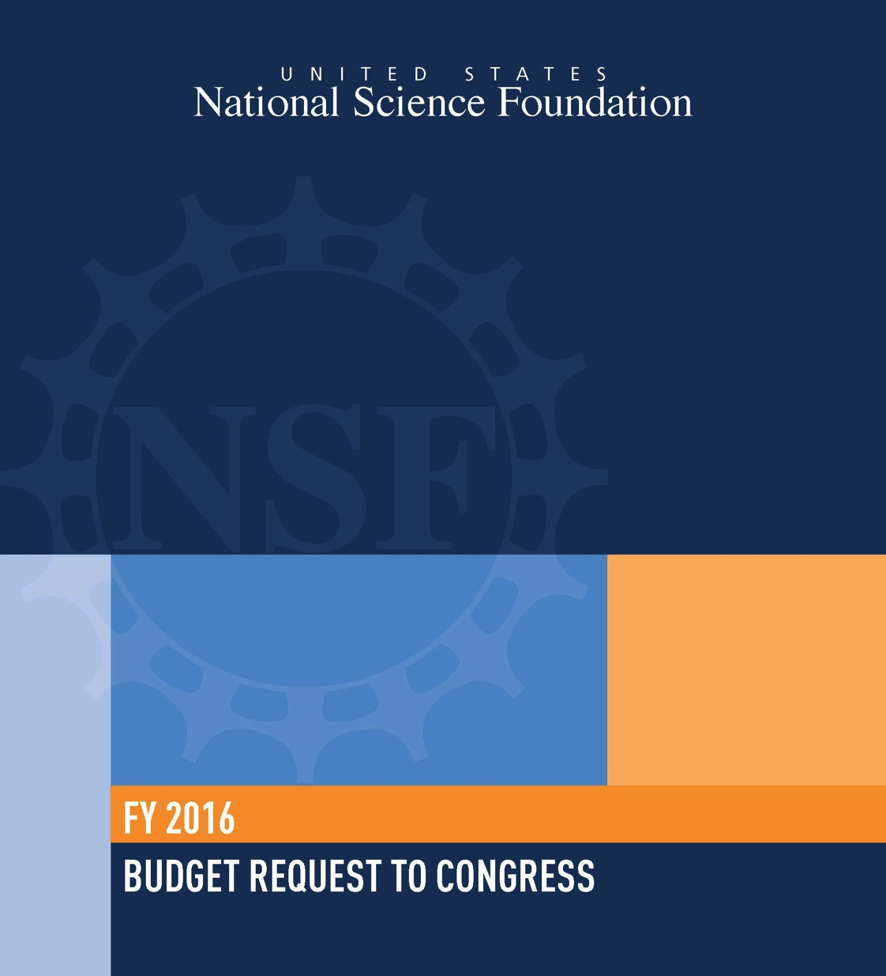
FY 2016 Budget Request
NSF
  FY 2016 Budget Request: $7723.55 Million
  Increase over FY 2015 Est: $379.34 Million, +5.2%
CISE
  FY 2016 Budget Request: $954.41 Million
  Increase over FY 2015 Est: $32.68 Million, +3.5%
CISE FY 2016 request is shaped by investments in core research, education, and infrastructure programs as well as critical investments in NSF cross-directorate priorities and programs.
Notes:
The President is requesting a total of $7,625.78 billion dollars for NSF in FY 2014. That’s an increase of $592.69 million, or 8.4% percent above the FY 2012 enacted level.
The request also includes an increase of $85.02Million or 9.8% above the FY2012 enacted level, for the Computer and Information Science and Engineering Directorate.
“In today’s changing economic landscape, science and technology are the new frontiers of American prosperity. The nation’s well being and global competitiveness depend, more than ever before, on the steady stream of new ideas and the highly skilled science, technology, engineering and mathematical talent that the National Science Foundation supports, and particularly the young researchers that NSF so skillfully nurtures.”
There is overwhelming consensus worldwide that scientific discovery and technological innovation, driven by a creative and skilled science and engineering workforce, are the new engines of economic growth.

Slide 9
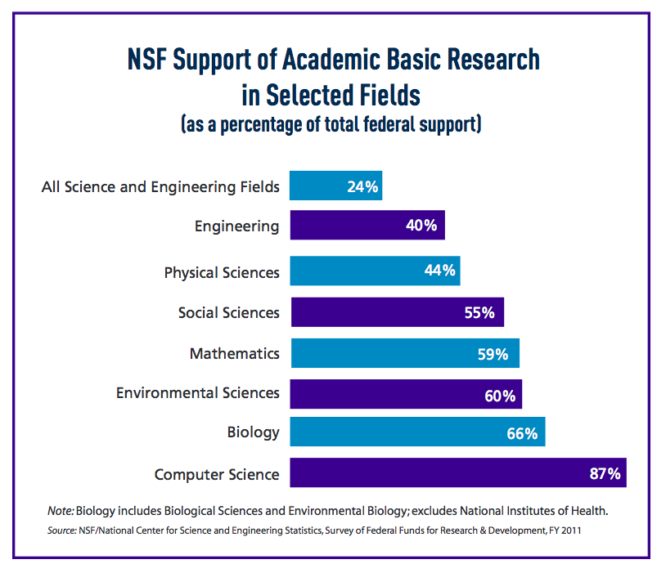
Notes:
NSF continues to be the dominant source of government-sponsored unclassified research funding for computer science and mathematics in this country.
-This number has gone up over the last decade as the research portfolios of other agencies has changed.
Graph from FY2015 budget brochure: http://www.nsf.gov/pubs/2014/nsf14041/nsf14041.pdf

Slide 10
CISE Mission
Exploring the frontiers of computing
Promote progress of computer and information science and engineering research and education, and advance the development and use of cyberinfrastructure.
Promote understanding of the principles and uses of advanced computer, communications, and information systems in support of societal priorities.
Contribute to universal, transparent and affordable participation in a knowledge-based society.
These frontiers have interfaces with all the sciences, engineering, education and humanities and a strong emphasis on innovation for society.
Notes:
CISE’s mission is to uphold the nation's leadership in computer and information science and engineering through its support for fundamental and transformative advances that are a key driver of economic competitiveness and crucial to achieving national priorities.
The Directorate does this by exploring the frontiers of computing. It promotes..

Slide 11
Snapshot of CISE FY 2014 Activities
Description | #
Research Budget | $893M
Number of Proposals | 7,436
Number of Awards | 1,682
Success Rate | ~23%
Average Annualized Award | $199K
Number of Panels Held | 302
Number of People Supported | 16,774
People Supported | #
Senior Researchers | 6,663
Other Professionals | 1,123
Postdoctoral Associates | 491
Graduate Students | 6,064
Undergraduate Students | 2,433

Slide 12
Who is the CISE Community?

Slide 13







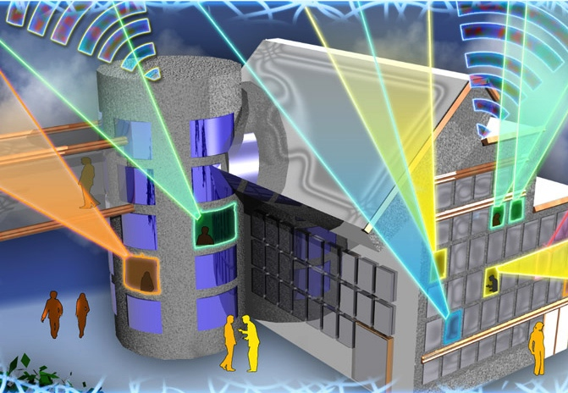
CISE and National Priorities
Image Credit: ThinkStock
Image Credits: Texas A&M University
Image Credit: NASA
Understanding the Brain
Risk & Resilience
Food-Energy-Water Systems
Health & Wellbeing
Image Credit: MicroStrain, Inc.
Image Credit: ThinkStock
Image Credit: Georgia Computes! Georgia Tech
Image Credit: Nicolle Rager Fuller, NSF
Manufacturing, Robotics, & Smart Systems
Secure Cyberspace
Education and Workforce Development
Broadband & Universal Connectivity
Notes:
TODAY, research by the CISE community is crucial in addressing many of our national priorities
From broadband access and universal connectivity, environment and sustainability, and on to healthcare, cyber security and workforce development.

Slide 14
CISE Organization
Office of the Assistant Director
Assistant Director: Dr. Jim Kurose
Deputy AD: Dr. Suzanne Iacono
Advanced
Cyberinfrastructure
ACI
Division Director
Ms. Irene Qualters
Acting Deputy DD:
Dr. Amy Friedlander
Computing and
Communications
Foundations
CCF
Division Director
Dr. Rao Kosaraju
Deputy DD:
Dr. James Donlon
Computer and
Network
Systems
CNS
Division Director
Dr. Keith Marzullo
Deputy DD:
Dr. Erwin Gianchandani
Information and
Intelligent
Systems
IIS
Division Director
Dr. Lynne Parker
Deputy DD:
Dr. Deborah Lockhart

Slide 15
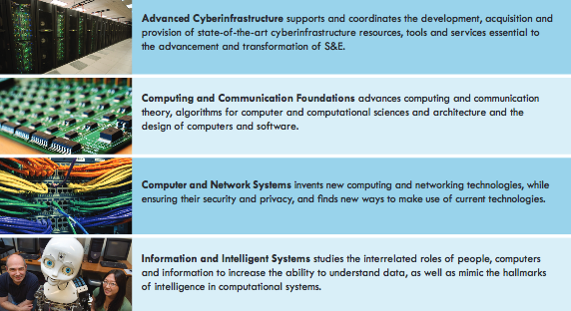
CISE Divisions

Slide 16
CISE Organization and Core Research Programs
CISE
Office of the Assistant Director
Computing and Communications Foundations (CCF)
Computer and Network Systems (CNS)
Algorithmic Foundations
Communication and Information Foundations
Software and Hardware Foundations
Computer Systems Research
Networking Technology and Systems
Information and Intelligent Systems (IIS)
Cyber Human Systems
Information Integration and Informatics
Robust Intelligence
Advanced Cyberinfrastructure (ACI)
Data
High Performance Computing
Networking/Cybersecurity
Software
CISE Core Programs
CISE Cross-Cutting Programs
Notes:
CISE Supports:
Investigator-initiated research in all areas of computer and information science and engineering
Cutting-edge national computing and information infrastructure for research and education
Education and training of the next generation of computer scientists and engineers
Through:
CISE Core programs
CISE Cross-cutting programs
NSF Cross-cutting programs

Slide 17
CISE International Activities
Science Across Virtual Institutes (SAVI): Wireless Innovation between Finland and U.S. (WiFiUS) (Tekes, Academy of Finland)
RAPIDs in 2011
Computational neuroscience (ANR, BMBF, BSF)
Robust intelligence (DFG)
SAVI: Future Internet (EU)
Algorithms & Software Foundations,
Secure & Trustworthy Cyberspace (BSF)
Pervasive computing (DIT)
Internet protocols and architecture (NICT)
Big Data for Disaster Management (Japan Science and Technology Agency)
SAVI: Global Research on Applying Information Technology to Support Effective Disaster Management (GRAIT-DM) (Japan’s National Institute of Informatics and the Japan Society for the Promotion of Science)
Notes:
Background: Technion CS building

Slide 18
Current CISE International Solicitations
Collaborative Research in Computational Neuroscience (CRCNS) - NSF 14-504
In collaboration with NIH (9 Institutes and Centers), French National Research Agency (ANR), Germany’s Federal Ministry of Education and Research (BMBF), and Israel Binational Science Foundation (BSF)
Aims to advance the understanding of the nervous system structure and function, mechanisms underlying nervous system disorders, and computational strategies used by the nervous system
International Research Network Connections (IRNC) - NSF 14-554 (FY15 deadline passed)
Aims to link U.S. research networks with peer networks in other parts of the world and leverage existing international network connectivity
US-Japan Big Data and Disaster Research (BDD) - NSF 14-575 (FY15 deadline passed)
In collaboration with the Japan Science and Technology Agency (JST)
Aims to address compelling research challenges that arise from leveraging Big Data approaches to transform, at both human and societal scales, disaster management
Wireless Innovation between Finland and US (WiFiUS) - NSF 14-563 (FY15 deadline passed)
In collaboration with Tekes and the Academy of Finland
Builds on the WiFiUS Science Across Virtual Institutes (SAVI) effort
Aims to address novel frameworks, architectures, protocols, methodologies and tools for the design and analysis of robust and highly dependable wireless networks, including cognitive radio networks

Slide 19
CISE Emerging Frontiers
Data Explosion
Expanding the Limits of Computation
Smart Systems: Sensing, Analysis and Decision
Secure Cyberspace
Universal Connectivity
Augmenting Human Capabilities

Slide 20
Advanced Cyberinfrastructure (ACI)
http://www.nsf.gov/div/index.jsp?div=ACI
Supports the acquisition, development, and provision of state-of-the-art cyberinfrastructure resources, tools, and services essential to the conduct of 21st century science and engineering research and education.
  Data: Support scientific communities in the sharing and archiving of, as well as computing with data by creating building blocks to address common community needs in data infrastructure.
  High Performance Computing: Enable petascale computing; provide open-science community with state-of-the-art HPC assets ranging from loosely coupled clusters to large scale instruments; develop an integrated scientific HPC environment.
  Networking and Cybersecurity: Invest in campus network improvements and re-engineering to support a range of activities in modern computational science. Support transition of cybersecurity research to practice.
  Software: Transform innovations in research and education into sustained software resources that are an integral part of cyberinfrastructure.

Slide 21
Computing & Communication Foundations (CCF)
http://www.nsf.gov/div/index.jsp?org=CCF
Supports research and education projects that explore the foundations of computing and communication devices.
  Algorithmic Foundations (AF): Innovative research characterized by algorithmic thinking and algorithm design, accompanied by rigorous mathematical analysis.
  Communications and Information Foundations (CIF): Transformative research addressing the theoretical underpinnings and current and future enabling technologies for information acquisition, transmission, and processing in communication and information networks.
  Software and Hardware Foundations (SHF): Foundational research essential to advance the capability of computing systems, including software and hardware components, systems, and other artifacts.

Slide 22
Computer and Network Systems (CNS)
http://www.nsf.gov/div/index.jsp?div=CNS
Supports research and education activities inventing new computing and networking technologies and exploring new ways to make use of existing technologies.
  Computer Systems Research (CSR): Transformative research on fundamental scientific and technological advances leading to the development of future generation computer systems, including new architectures; distributed real-time embedded devices; pervasive, ubiquitous and mobile computing; file and storage systems; operating systems; reliable, fault-tolerant and secure hard/middle/software.
  Networking Technology and Systems (NeTS): Transformative research on fundamental scientific and technological advances leading to the understanding, development, engineering, and management of future-generation, high-performance computer networks.

Slide 23
Information and Intelligent Systems (IIS)
http://www.nsf.gov/div/index.jsp?div=IIS
Supports research and education activities that study the inter-related roles of people, computers, and information.
  Cyber-Human Systems (CHS): Research to accelerate the creation and understanding of the complex and increasingly coupled relationships between humans and computing with the broad goal of advancing human capabilities: perceptual and cognitive, physical and virtual, social and societal.
  Information Integration and Informatics (III): Information technology research on the processes and technologies involved in creating, managing, visualizing, and understanding diverse digital content in circumstances ranging from individuals through groups, organizations, and societies, and from individual devices to globally-distributed systems, and that can transform all stages of the knowledge life cycle.
  Robust Intelligence (RI): Research that encompasses all aspects of the computational understanding and modeling of intelligence in complex, realistic contexts to advance and integrate the traditions of artificial intelligence, computer vision, human language research, robotics, machine learning, computational neuroscience, cognitive science, and related areas.

Slide 24
Applying to Core Programs
Program Solicitations:
  CCF: NSF 14-598
  CNS: NSF 14-597
  IIS: NSF 14-596
Project Types:
  Large: $1,200,001 to $3,000,000; up to 5 years, collaborative teams
      Medium: $500,001 to $1,200,000; up to 4 years, multi-investigator teams
  Small: up to $500,000; up to 3 years, one or two investigators
CISE-wide Submission Windows:
  Large: November 12 - 20
  Medium: October 27 – November 10
  Small: January 2 – 14
PI Limit:
  Participate in no more than 2 “core” proposals/year
Coordinated
Solicitations
For a comprehensive list of CISE funding opportunities, visit:
http://www.nsf.gov/funding/pgm_list.jsp?org=CISE

Slide 25
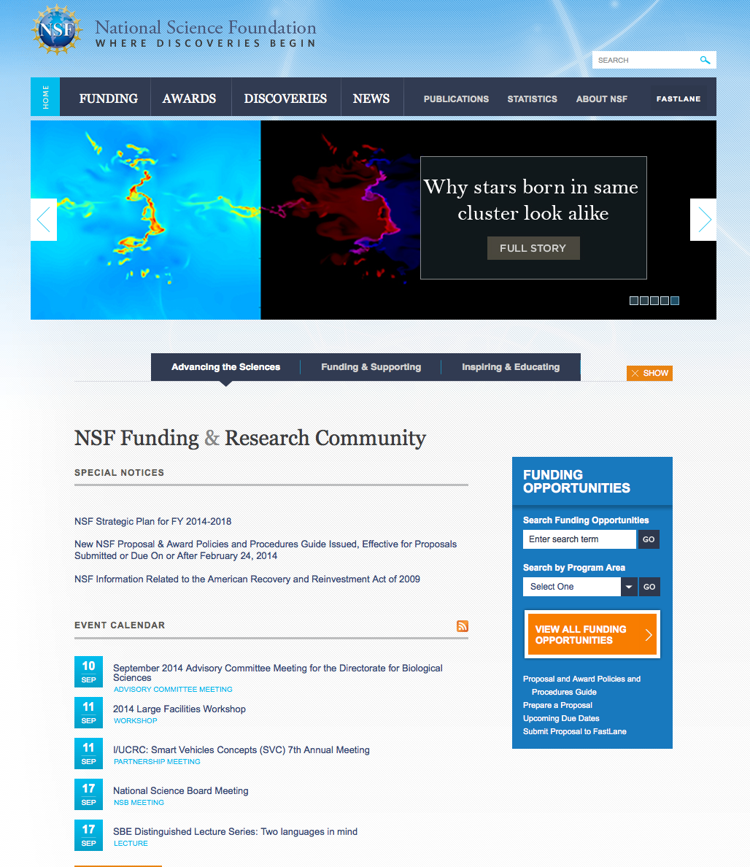
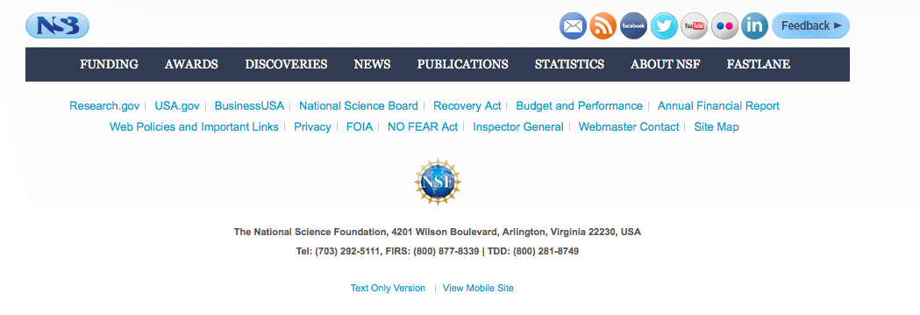
CISE News
Subscribe to get NSF updates by email at www.nsf.gov.
Subscribe to receive special CISE announcements:
  Send a message to: join-cise-announce@lists.nsf.gov with no text in the subject or message body.
Visit the CISE website often: http://www.nsf.gov/dir/index.jsp?org=CISE.
Talk to Program Directors: http://www.nsf.gov/staff/staff_list.jsp?org=CISE&from_org=CISE.
Follow us on Twitter @NSF_CISE.
Get NSF Updates by Email

Slide 26
Tips for Applying to NSF

Slide 27
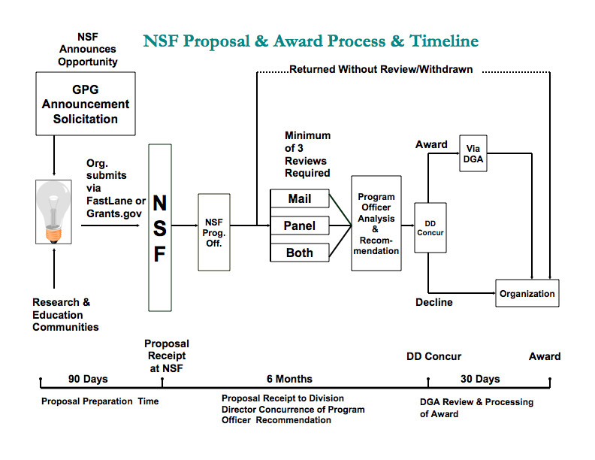
Proposal Cycle and Merit Review Process

Slide 28
Tips for International Proposals (1 of 4)
Look for content, not a “big name” in collaborators
  NSF dislikes “trust me” proposals
  But work with someone who has been funded before - very hard to write an NSF proposal without having seen one before!
How to choose a partner
  Work with someone experienced (junior or senior)
  Someone who is overloaded is not a good partner
    Impact of NSF 2 month/year support limit
  EPSCoR states are nice, but NOT a requirement
  Participation of underrepresented groups is important but not required
    Women
    African Americans
    Hispanics
    Native Americans
    etc

Slide 29
Tips for International Proposals (2 of 4)
Role of the Israeli partner
  Both should be full partners, not just figureheads
  Collaboration plan helpful to explain roles
    Depending on program, as separate document or in proposal (may count against page limit)
NSF evaluation process
  In nearly all cases, peer review panel provides advice to program officers who make recommendations to NSF management
  Careful avoidance of Conflict of Interest
  PI receives technical reviews and panel summary
  Proposals are rated (scales vary by program, but typically Highly Competitive, Competitive, Low Competitive, or Not Competitive)

Slide 30
Tips for International Proposals (3 of 4)
Post panel considerations in award decisions
  Program officers generally but not always follow panel advice
  Includes consideration of overall budget, “portfolio balancing”, PI workload, etc.
    HC proposals are usually funded
    C proposals are sometimes funded
    LC proposals are very occasionally funded
    NC proposals are almost never funded
Project funding rates
  Wide range of funding rates across foundation
  Ex: CISE averages ~20%, but some programs as little as 5% or as high as 35%
  Some (but not all) programs will give statistics

Slide 31
Tips for International Proposals (4 of 4)
Broader impact must be addressed in every proposal
  How well does the activity advance discovery and understanding while promoting teaching, training and learning?
  How well does the proposed activity broaden the participation of underrepresented groups (e.g., gender, ethnicity, disability, geographic, etc.)?
  To what extent will it enhance the infrastructure for research and education, such as facilities, instrumentation, networks and partnerships?
  Will the results be disseminated broadly to enhance scientific and technological understanding?
  What may be the benefits to society of the proposed activity?
Must address some of these in every proposal
Proposals without BI are returned without review
Both Intellectual Merit and Broader Impact are considered in funding decisions

